Slide 1
SWE3002
Information System and Security
Module : Public Key Crypto System
Prof. Jayasudha M
VIT Chennai

Slide 2
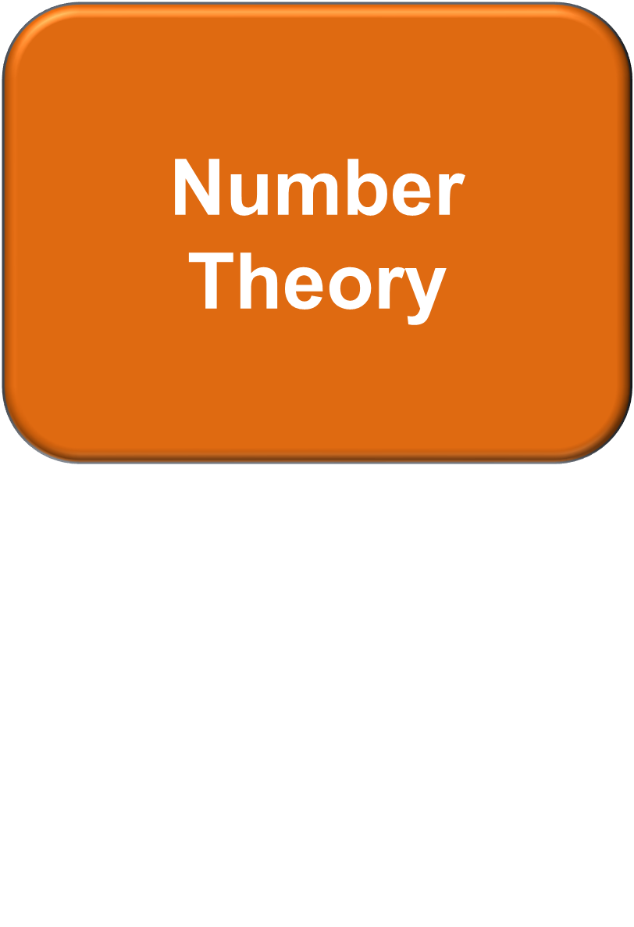
Prof M Jayasudha,VIT Chennai,India

Slide 3
Learning Outcomes
Solve problems in elementary number theory
Apply elementary number theory to cryptography
Develop a deeper conceptual understanding of the theoretical basis of number theory and cryptography
Prof M Jayasudha,VIT Chennai,India

Slide 4
Number Theory - Basics
Cryptography is based on number theory
Inability to factor of the product of large prime numbers
PKC is based on large primes that have to be generated and tested using modular arithmetic
Fermat and Euler’s work is used to prime or relatively prime numbers
Euclid’s algorithm finds multiplicative inverse to find appropriate encryption keys
Prof M Jayasudha,VIT Chennai,India

Slide 5
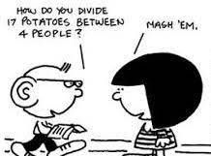

Divisibility
Consider
a positive integer n
any integer m
Euclidean division algorithm
we have m = q*n+r
for some integer q and 0 ≤ r < n
we call q the quotient, r the remainder
e.g. with n = 7,
If m = 17, q = 2, r = 3
If m = 35, q = 5, r = 0
If m = -5, q = -1, r = 2
Given n & m: q and r are unique , m mod n = r
if r=0, n divides m ,m is divisible by n denoted as: n|m
Prof M Jayasudha,VIT Chennai,India

Slide 6
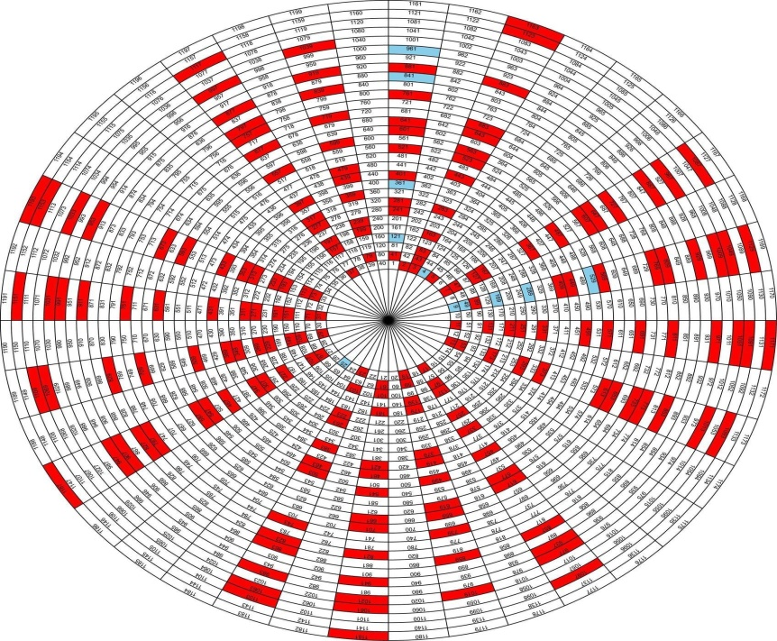
Prime Numbers
Definition:
A positive integer p > 1
iff its only divisors are ±1 and ±p
the largest known prime number is 2^{74,207,281} − 1, a number with 22,338,618 digits.
It was found in January 2016 by the Great Internet Mersenne Prime Search (GIMPS)
Image source: https://www.geek.com/wp-content/uploads/2013/10/primes.jpg
Prof M Jayasudha,VIT Chennai,India

Slide 7
Greatest Common Divisor
  greatest common divisor of integers a and b, gcd(a,b) is the
largest (positive) integer that divides both of them
gcd(a,b) = max[k, such that k|a and k|b]
Two integers are relatively prime, if their gcd is one (i.e., only common positive integer factor is 1)
d=gcd(a,b) iff: d is a divisor of both a and b
any divisor of a and b is a divisor of d
Notice that we get results like 26 and 27, which we cannot turn back into letters
Example: gcd(45,30) = gcd(-30,45) = 15
gcd(a,b) = gcd(a,-b) = gcd (-a,b) = gcd (-a,-b) = gcd(|a|,|b|) gcd(a,b) = gcd(b,a)
gcd(a,0) = |a|
gcd(0,0) = 0
Prof M Jayasudha,VIT Chennai,India

Slide 8
Euclidean algorithm
Since gcd(a,b) = gcd(b,a) = gcd(|a|,|b|),
w.l.g., assume: a ≥b>0
say:
d=gcd(a,b)
a=q₁*b+r₁ where 0≤r₁<b
case:
If r₁=0 then b|a →gcd(a,b)=b
If r₁≠0 then
since, d|b ∧ d|a, ∴ d|(a-q₁*b), i.e. d|r₁
therefore, d=gcd(b,r₁)
function gcd(a, b)
if b = 0
return a;
else
return gcd(b, a mod b);
The accompanying pseudocode is written slightly differently
Prof M Jayasudha,VIT Chennai,India

Slide 9
Euclidean algorithm Cont.,
we have:
d=gcd(a,b)=gcd(b,r₁)
now consider gcd(b,r₁):
using same line of reasoning
gcd(b,r₁)=gcd(r₁,r₂)
where b= q₂*r₁+r₂
so we have: d=gcd(a,b)=gcd(b,r₁) =gcd(r₁,r₂)
d=gcd(a,b)=r_{n}
function gcd(a, b)
if b = 0
return a;
else
return gcd(b, a mod b);
a=q₁b + r₁ 0<r₁<b
b=q₂r₁+ r₂ 0<r₂<r₁
r₁=q₃r₂+r₃ 0<r₃<r₂
Prof M Jayasudha,VIT Chennai,India

Slide 10
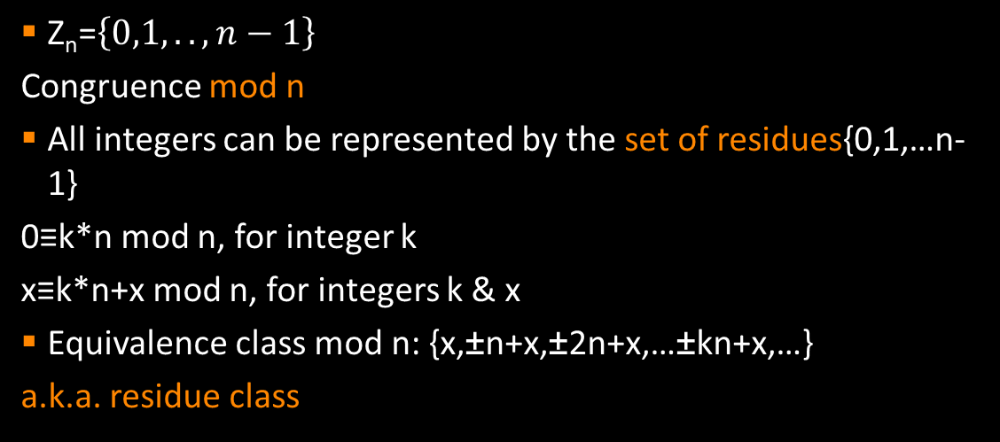
Modular arithmetic
e.g. mod 9, we have {…,−27,−18,−9, 0, 9,18,27,…} represented by 0,
{...,−26,−17,−8, 1, 10,19,28,…} represented by 1, and so on …
≡ and = used interchangeably
e.g.
71≡ 50 mod 7 71 mod 7 = 50 mod 7 71 = 50 mod 7
Prof M Jayasudha,VIT Chennai,India

Slide 11
Example Z₈
w -w w⁻¹
0
1 | Exercise
2
3
4
5
6
7
Prof M Jayasudha,VIT Chennai,India

Slide 12
Example Z₈
w -w w⁻¹
0 | 0 | -
1 | 7 | 1
2 | 6 | -
3 | 5 | 3
4 | 4 | -
5 | 3 | 5
6 | 2 | -
7 | 1 | 7
Prof M Jayasudha,VIT Chennai,India

Slide 13
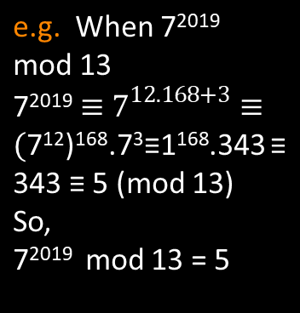
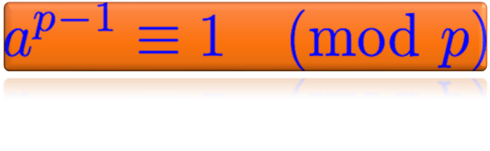
Fermat’s(little) Theorem
If:
A prime number p
A positive integer a not divisible by p
The converse of the statement is however false!
Prof M Jayasudha,VIT Chennai,India

Slide 14
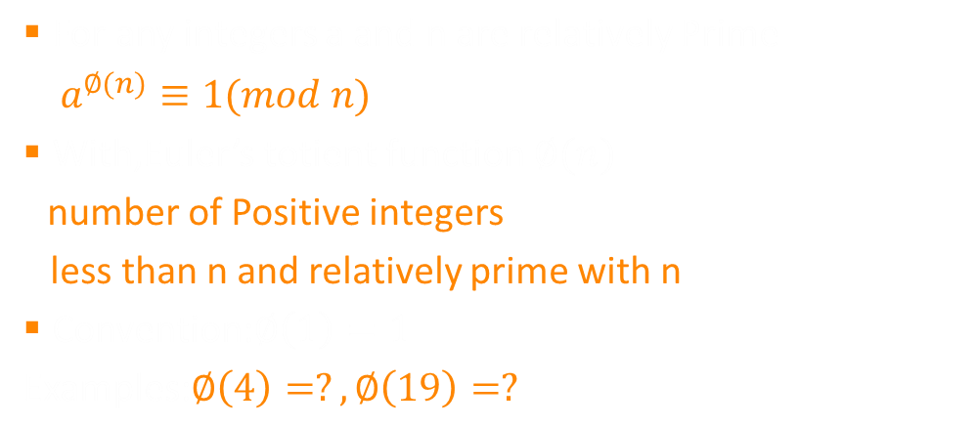
Euler’s totient Theorem
Ans: 2, 4
Prof M Jayasudha,VIT Chennai,India

Slide 15
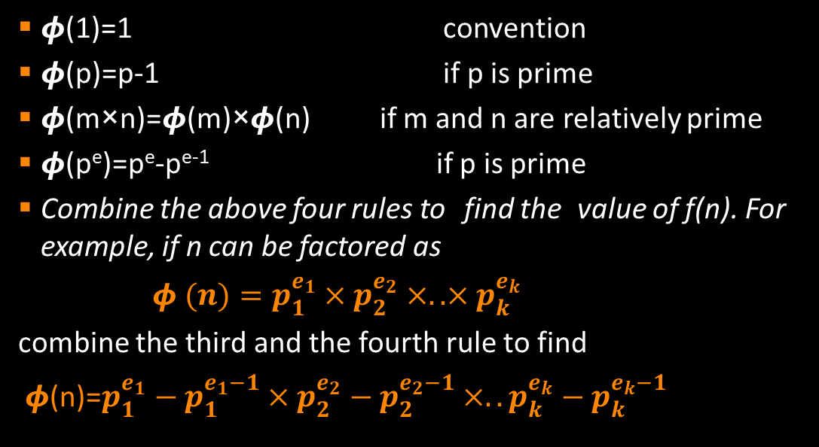
Euler’s totient function
Prof M Jayasudha,VIT Chennai,India

Slide 16
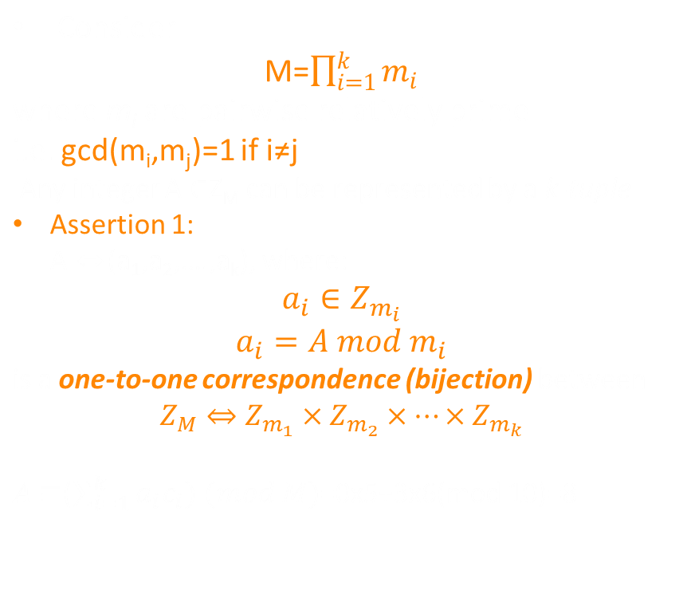
Chinese Reminder Theorem
Assertion 1: example
Consider M=10=2×5
So: m1=2, m2=5 ⇒ M1=10/2=5, M2=210/5=2 [Hint : M_{i}=M/m_{i} ]
c1= 5 × (5-1 mod 2) = 5×1=5
c2= 2 × (2-1 mod 5) = 2×3 =6
[Hint :c_{i} = M_{i} × (M_{i}⁻¹ mod m_{i})]
Consider A=8, then we have 8 ↔ (0,3), i.e. a1=0, a2=3
Prof M Jayasudha,VIT Chennai,India

Slide 17

Chinese Reminder Theorem
Similar for Subtraction and Multiplication operators
Prof M Jayasudha,VIT Chennai,India

Slide 18


Slide 19
Learning Outcomes
To distinguish between two cryptosystems:
Symmetric key and Asymmetric key
Principles of Public key cryptosystem
To discuss the RSA & Diffie-Hellman Key Exchange Algorithm
To introduce the usage of Asymmetric key cryptosystem

Slide 20
Public Key Cryptography
Uses a Public key and Private key.
In 1976, Diffie and Hellman proposed the use of different keys for encryption and decryption
Also known as Asymmetric Cryptography.
Asymmetric Cryptography are complements to the symmetric key(secret key).
The use of two keys has consequences
Key distribution, confidentiality and Authentication
Symmetric key also called Secret-key
Asymmetric key also called Public-key
Prof M Jayasudha,VIT Chennai,India

Slide 21
Principles of PKC
Evolved from an attempt to solve two of the most difficult problems associated with symmetric encryption.
Key Distribution – To have secure communication without trusting KDC with your key.
Digital Signature – To verify that a message comes intact from the claimed sender.
In 1976, a method was proposed to address both problems. Solution: Diffie Hellman Exchange, RSA
Prof M Jayasudha,VIT Chennai,India

Slide 22
Public Key Characteristics
Computationally infeasible to find private key knowing only algorithm & public key.
computationally easy to encrypt/decrypt messages when the relevant (private/public) key is known
either of the two related keys can be used for encryption and other is used for decryption
Prof M Jayasudha,VIT Chennai,India

Slide 23

PKC Pictorial Scenario
Sender
Different keys are used to Encrypt and Decrypt
Receiver
Plaintext
Ciphertext
Plaintext
Encryption
Decryption
Prof M Jayasudha,VIT Chennai,India

Slide 24
Components of Public Key Encryption
Plaintext : The original message, before being transformed
Ciphertext : After the message is transformed in an encrypted form
Encryption : Process of converting plaintext into ciphertext
Decryption : Process of converting cipher text into plaintext
Public Key &Private key : one key used for Encryption and other key used for Decryption
To encrypt a message : Need an encryption algorithm – Input : an encryption key, and the plaintext - Output: Ciphertext
To decrypt a message : Need a decryption algorithm – Input: a decryption key, and the ciphertext – Ourput: The original plaintext
Prof M Jayasudha,VIT Chennai,India

Slide 25
Confidentiality
Protecting the information from disclosure to unauthorized parties.
Ensures that only the right people (people who knows the key) can read the information.
Prof M Jayasudha,VIT Chennai,India

Slide 26
PKC works
Each system generates a pair of keys.
Each system publishes its public key keeping its companion key private.
If A wishes to send a message to B then it encrypts the message using B’s public key.
When B receives the message, it decrypts the message using its private key. No one else can decrypt the message because only B knows its private key.
Prof M Jayasudha,VIT Chennai,India

Slide 27
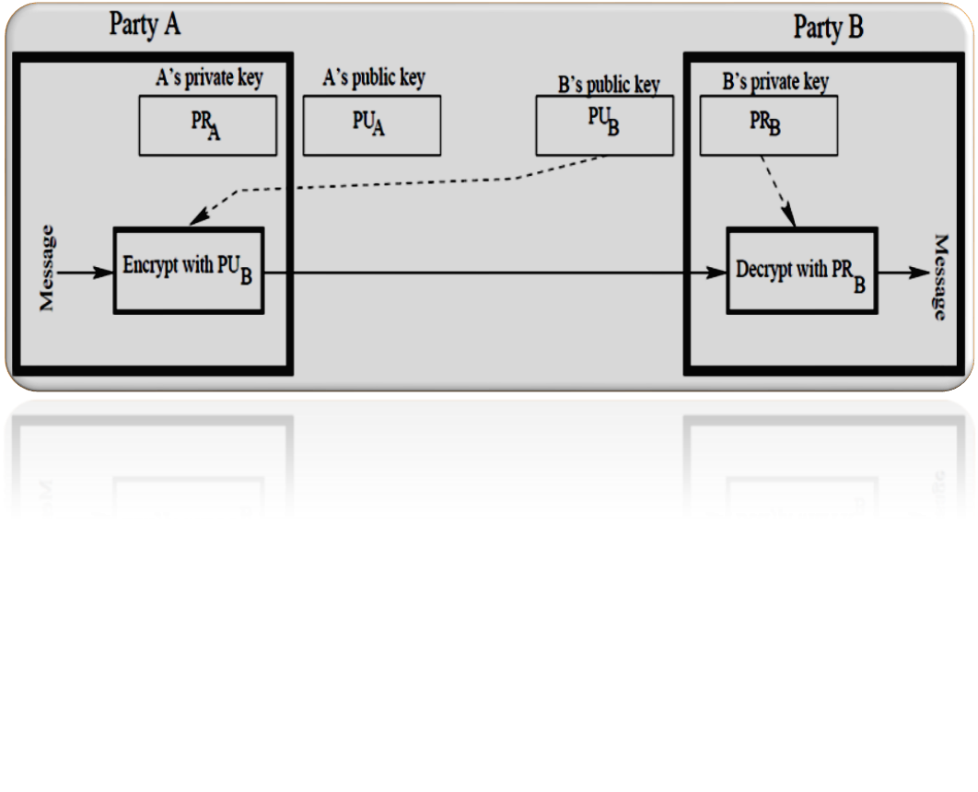
Cont.,
Party A wants to send a message to Party B
When only Confidentiality is needed
A’s Private key and public keys-PR_{A} , PU_{A}
B’s Private key and public keys-PR_{B} , PU_{B}
C = E(PU_{B},M)
M= D(PR_{B},C)
Prof M Jayasudha,VIT Chennai,India

Slide 28
Authentication
The sender and receiver can confirm each other’s identity and origin/destination of the information
When only authentication is needed
Prof M Jayasudha,VIT Chennai,India

Slide 29
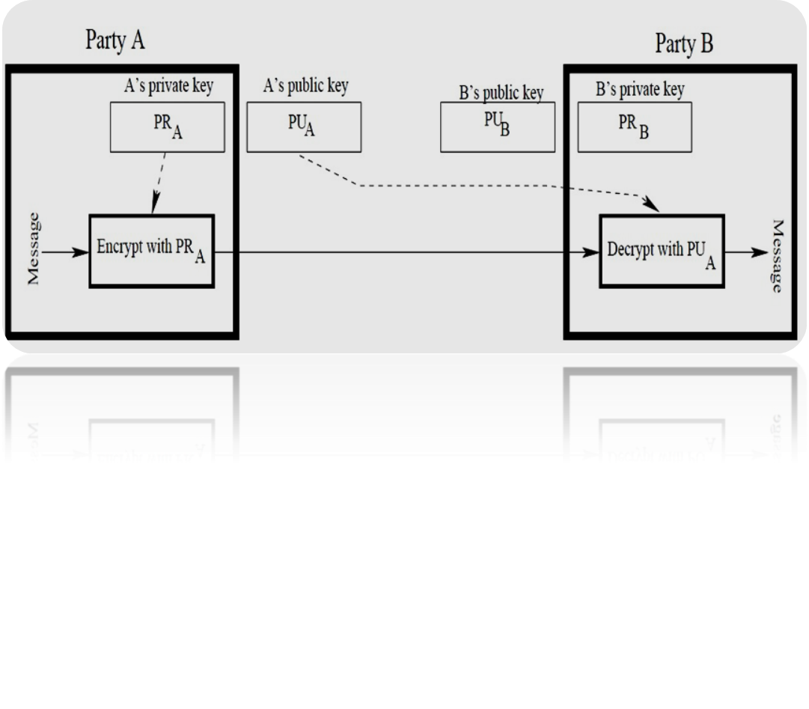
Cont.,
A’s Private key and public keys-PR_{A} , PU_{A}
B’s Private key and public keys-PR_{B} , PU_{B}
C = E(PR_{A},M)
M= D(PU_{A},C)
Prof M Jayasudha,VIT Chennai,India

Slide 30
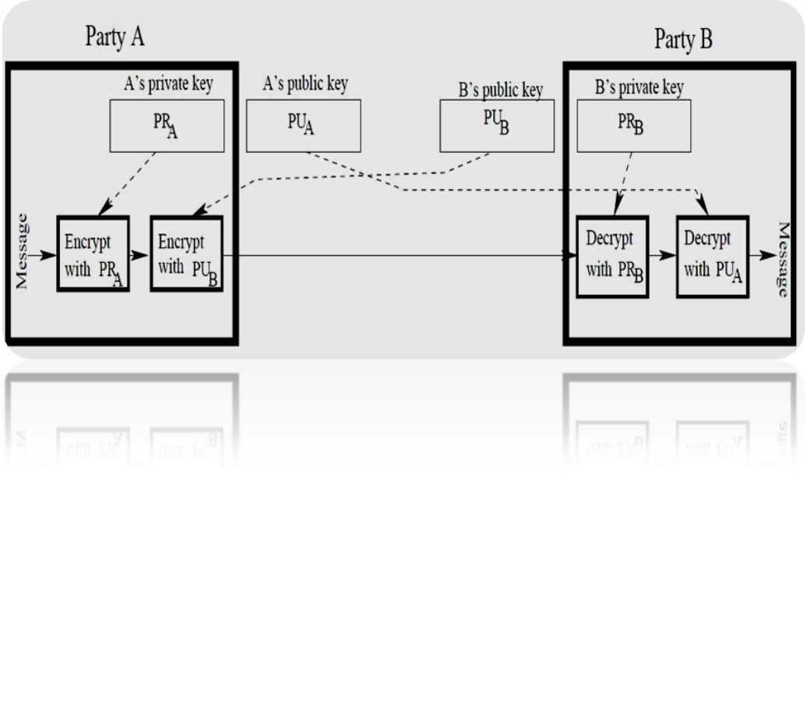
Authentication and Confidentiality
A’s Private key and public keys-PR_{A} , PU_{A}
B’s Private key and public keys-PR_{B} , PU_{B}
C = E[PU_{B},E(PR_{A},M)]
M= D[PU_{A},D(PR_{B},C)]
Prof M Jayasudha,VIT Chennai,India

Slide 31
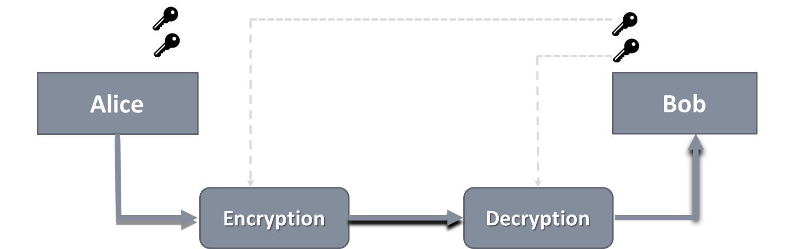
Public Key Applications
Digital Signature : Sender “signs” a message with its private key – ensures authentication
Key exchange: Two sides cooperate to exchange a session key / secret key – Diffie-Hellman Exchange Algorithm
Provide authentication or proof of origin
Prof M Jayasudha,VIT Chennai,India

Slide 32
RSA Algorithm
The most common public key algorithm- named for its inventors Rivest, Shamir, and Adleman (RSA) – year 1977
Block cipher scheme
Plaintext and ciphertext are numbers – between 0 and n-1 for some n
Typical size of n is 1024 bits (309 decimal digits)
Make use of an expression with exponentials
Having key generation algorithms, encryption and decryption algorithms
Prof M Jayasudha,VIT Chennai,India

Slide 33
Mathematics behind RSA
Theorem 1 : Let a, p be two integers that are co-prime to each other. Then, there is only a unique integer x ∈ Zp satisfying
ax mod p = b (Regardless of the value of b.)
Corollary(1) : If a and p are co-prime to each other, then 0, a, 2a, ..., (p - 1)a are all distinct after modulo p.
Theorem 2(Fermat’s Little Theorem) : If p is a prime number, for any non-zero a ∈ Zp, it holds that
a ⁽ ^{p-1)} mod p =1
Theorem 3(Chinese Remainder Theorem) : Let p and q be two co-prime integers. Then
If x mod p = 1 and x mod q = a then x mod pq = a
Prof M Jayasudha,VIT Chennai,India

Slide 34
Mathematics behind RSA
Eulers Totient Function(ø) : When doing arithmetic modulo n then
The complete set of residues is: 0...(n-1)
The reduced set of residues is those numbers (residues) which are relatively prime to n
Number of elements in reduced set of residues is called the Euler Totient Function ø(n)
If the the number ‘n’ is a prime number then the value of
ø(n)=n-1
Prof M Jayasudha,VIT Chennai,India

Slide 35
RSA Algorithm
Key Generation
p,q two prime numbers (private, chosen)
Compute n = pq; φ(n)=(p-1)(q-1) (public, calculated)
Select e, with gcd( φ(n), e) = 1; 1 < e < φ(n) (public , chosen)
Find d = e⁻¹ (mod φ(n)) (private, calculated)
Now, private key {d,n} public key {e,n}
Prof M Jayasudha,VIT Chennai,India

Slide 36

RSA Algorithm
Encryption
User A
private key {d_{A}, n}
public key {e_{A},n}
Assume User A wants to send a message M < n
User B
private key {d_{B}, n}
public key {e_{B},n}
e_{B}
User B’s public key
_{Compute C=} _{M} e_{B mod n}
Ciphertext ‘C’
Prof M Jayasudha,VIT Chennai,India

Slide 37
RSA Algorithm
Decryption
User A
private key {d_{A}, n}
public key {e_{A},n}
User B
private key {d_{B}, n}
public key {e_{B},n}
Ciphertext ‘C’
_{Compute M=} _{C} d_{B mod n}
Original Message sent by User A
Prof M Jayasudha,VIT Chennai,India

Slide 38
RSA Algorithm
Example :Alice wants to send a message M=88 to Bob
Key Generation Process for Bob
p=17, q=11 two prime numbers
Compute n=pq =17*11=187; φ(n)=(p-1)(q-1)=16*10=160
e=7, with gcd( 160, 7) = 1; 1 < 7 < 160
d = 7⁻¹ (mod 160) i.e. e*d= 1 mod 160 7*23 = 1 mod 160 [Apply extended Euclid’s Algorithm]
Now, Bob’s private key {23,187} public key {7,187}
Prof M Jayasudha,VIT Chennai,India

Slide 39
RSA Algorithm
Encryption
Alice
private key {d_{A}, n}
public key
{e_{A}, n}
Alice wants to send a message 88 < 187
Bob
private key {23,187}
public key {7,187}
7
Bob’s public key
_{Compute C=} ₈₈ 7 _{mod 187}
Ciphertext ’11’
Prof M Jayasudha,VIT Chennai,India

Slide 40
RSA Algorithm
Decryption
Alice
private key {d_{A}, n}
public key {e_{A},n}
Bob
private key {23, 187}
public key {7,187}
Ciphertext ‘11’
_{Compute M=} ₁₁ 23 _{mod 187}
Original Message M=88 sent by Alice
Prof M Jayasudha,VIT Chennai,India

Slide 41
Applications
To protect web traffic, in the SSL protocol (Security Socket Layer),
To guarantee email privacy and authenticity in PGP (Pretty Good Privacy)
To guarantee remote connection in SSH (Secure Shell).
Furthermore it plays an important role in the modern payment systems through SET protocol (Secure Electronic Transaction).
RSA has been used in most digital data, information and telephone security applications.
Prof M Jayasudha,VIT Chennai,India

Slide 42




Diffie-Hellman Key Exchange Algorithm
Global Public Elements
q Prime number
α α < q and α a primitive root of q
User A Key Generation
Select XA XA<q
Calculate YA YA=α^{XA} mod q
User B Key Generation
Select XB XB<q
Calculate YB YB=α^{XB} mod q
YB
YA
Secret key generation
K = (YB)^{XA} mod q
Secret key generation
K = (YA)^{XB} mod q
Prof M Jayasudha,VIT Chennai,India

Slide 43


Diffie-Hellman Key Exchange-Example
Global Public Elements
q=97 Prime number
α=5 α < q and α a primitive root of q
User A Key Generation
Select XA=36 XA<q
Calculate YA=5³⁶ mod 97
User B Key Generation
Select 58 XB<q
Calculate YB=5⁵⁸ mod 97
YA =50
YB =44
Secret key generation
K = (44)³⁶ mod 97=75
Secret key generation
K = (50)⁵⁸ mod 97=75
Prof M Jayasudha,VIT Chennai,India

Slide 44
Reference
Alfred J. Menezes,Paul C. Van Oorschot and Scott A. Vanstone,” A Handbook of Applied Cryptography”, CRC Press Series on Discrete Mathematics and Its Applications
www.khanacademy.org
www.tutorialpoints.com

